Slide 1
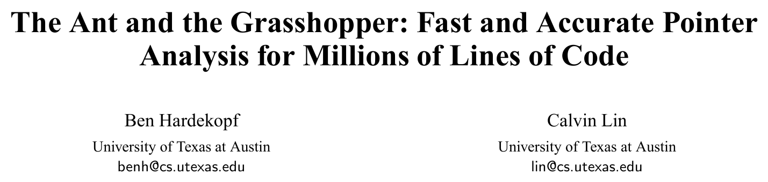
PLDI’ 07

Slide 2
Outline
Background
LCD & HCD
Related Work
Results
Demo: Constraint Solving via Racket!

Slide 3
Background
Anderson Pointer analysis
Constraint Graph
Cycle detection

Slide 4
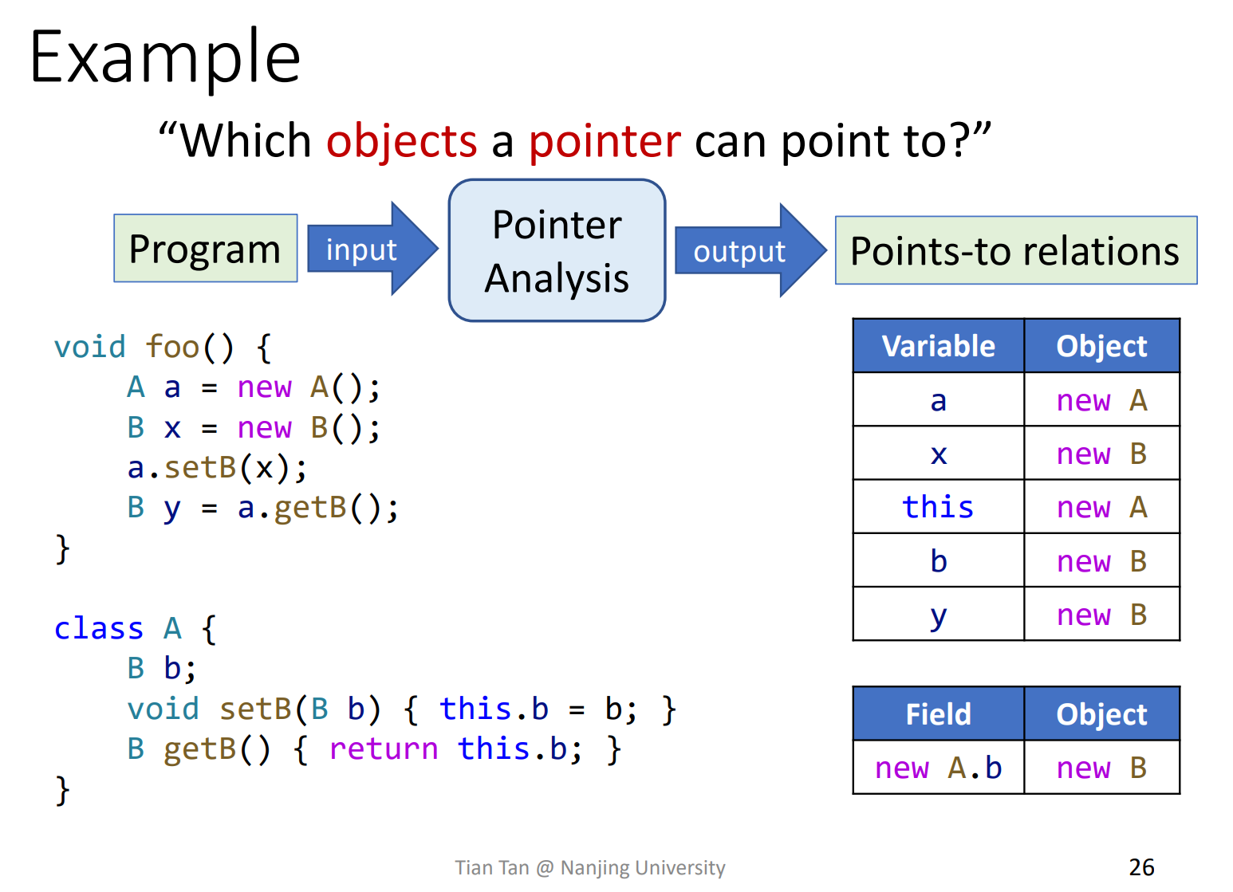
Recap: Anderson pointer analysis

Slide 5
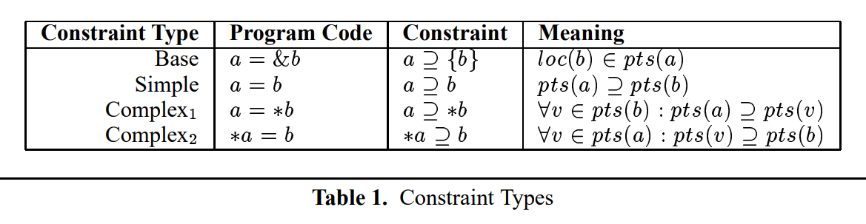
Semantics & constraints
Constraints = Statement Semantics
Solution satisfying all constraints = Desired points-to relation
“Less is better” under constraints
Propagate points-to facts in constraint graph

Slide 6
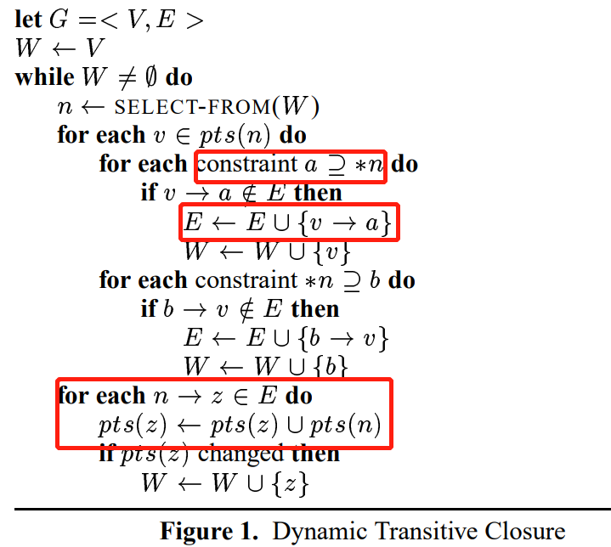
Basic Algorithm of Constraints Solving
Hint: static edges are added before the worklist algorithm
Phase 1: add dynamic edges
Phase 2: propagate points-to set to successors

Slide 7
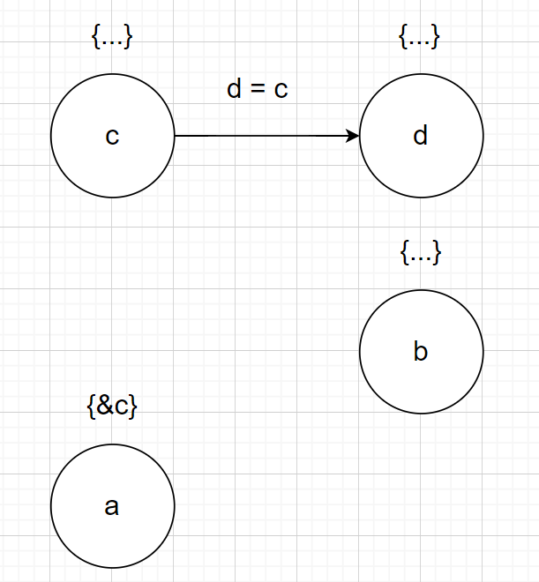
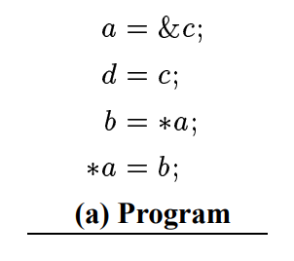
Snapshot of Constraint Graph
“static” edges

Slide 8
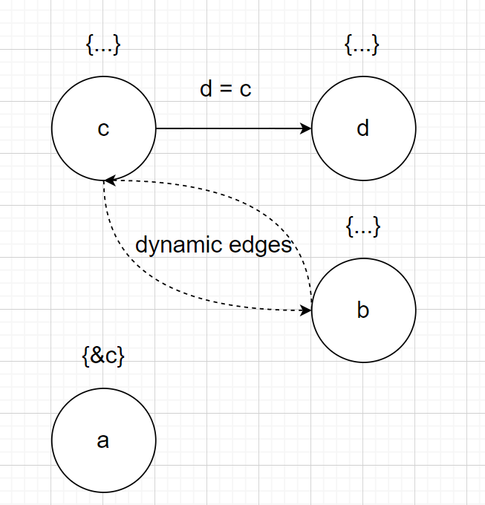
Snapshot of Constraint Graph
“dynamic” edges

Slide 9
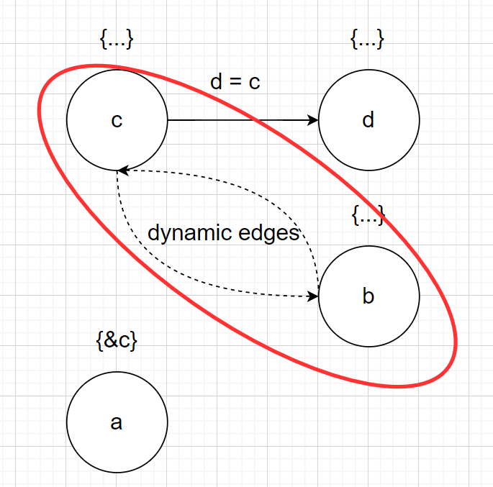
Why Cycle detection?
Assume that, “a->b” and “b->a”, According to constraints, we have
Pts(a) ⊆ Pts(b)
Pts(b) ⊆ Pts(a)
Which means Pts(a) = Pts(b). So we can merge them at first and avoid the propagation.

Slide 10
Cycle Detection: a Naïve Way
Detect cycle whenever a new edge is inserted
All cycles will be found
Too much overhead
Incomplete Cycle Detection?
No need to detect all cycles
A tradeoff

Slide 11
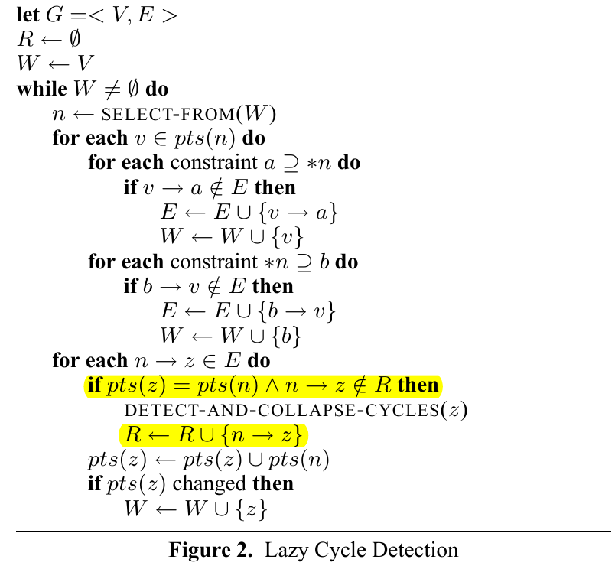
Lazy Cycle Detection(LCD)
Detect cycle only when there is likely a cycle
Phase 2: before propagation, do these 2 nodes already have identical points-to set?
e.g. we have “a->b” before, and now “b->a”

Slide 12
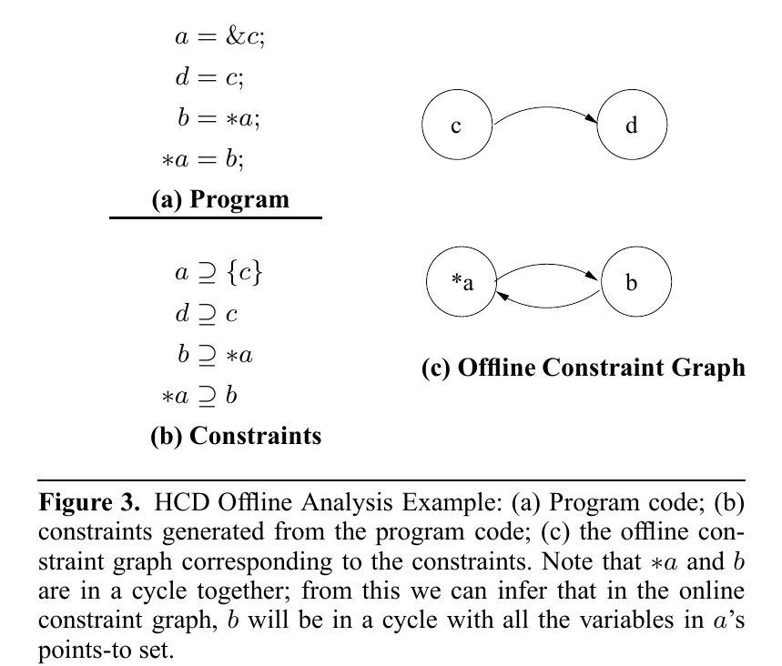
Hybrid Cycle Detection(HCD)
Split some work to offline analysis
Before pointer analysis: build offline constraint graph(identify SCC)
Collapse cycle when doing pointer analysis

Slide 13
Related Work
Partial online CD[4]
Restricted DFS(at every edge insertion)
HT[5]
Pre-transitive constraint graph
CD as a side-effect of graph traversal when requested
PKH[6]
Periodically CD
BLQ[7]
BDD as points-to set representation

Slide 14
Results
LCD: 1.05× HT, 2.1× PKH, and 6.8× BLQ
HCD: 3.2×HT, 5× PKH, 1.1× BLQ, and 3.2× LCD
LCD+HCD: 3.2× HT, 6.4× PKH, and 20.6× BLQ

Slide 15
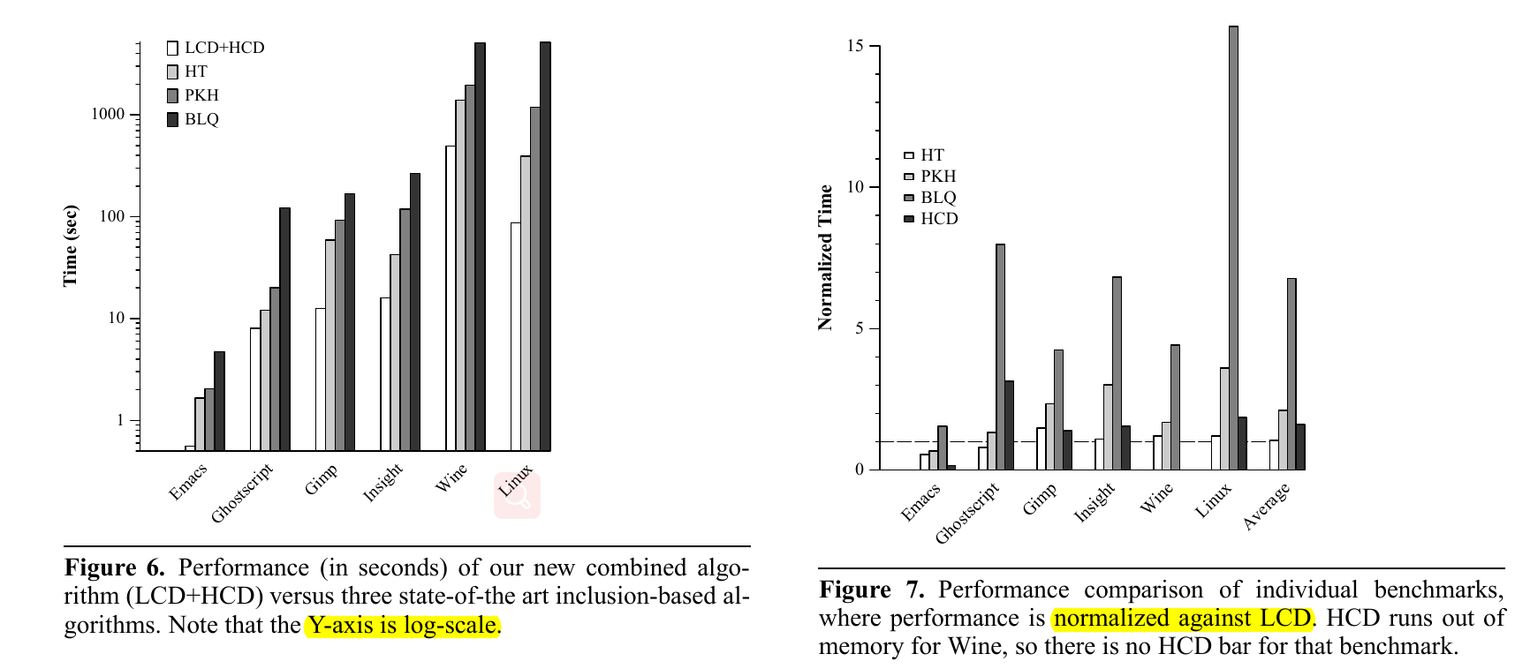
Results

Slide 16
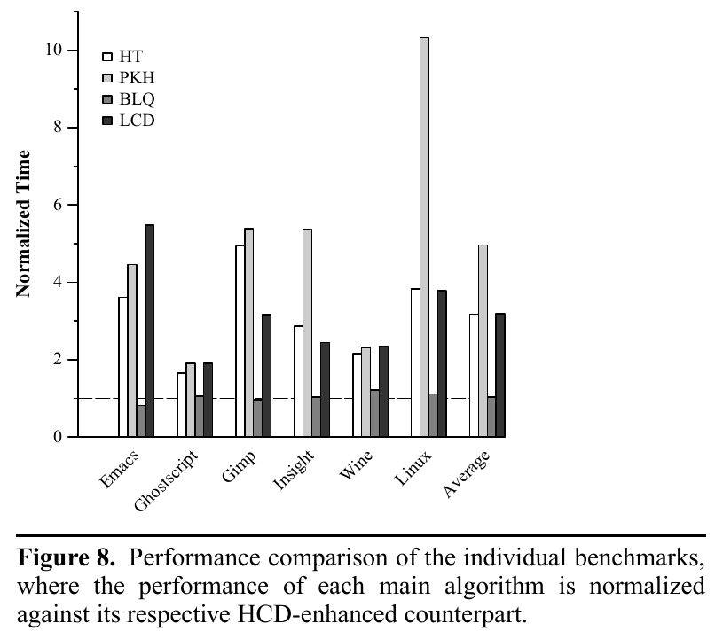
Results: Integrating HCD
HT 3.2×
PKH 5×
BLQ 1.1×
LCD 3.2×

Slide 17
Constraint Solving
Anderson pointer analysis is some kind of constraint solving, Use a off-the-shelf solver?
Optimization left to the solver
“cycle” is some kind of domain knowledge
Constraints of pointer analysis?
flows_to(X, Y) :- assign(Y, X).
flows_to(X, Y) :- points_to(P, X), load(Y, P).
flows_to(X, Y) :- points_to(P, Y), store(P, X).
points_to(X, Y) :- points_to(SRC, Y), flows_to(X, SRC).

Slide 18
Q&A

